Slide 1

Risk Radar
Team 5

Slide 2
Problem
Investors cannot accurately predict whether investing in a certain country will be worth it or not. This can lead to monetary losses.
Research question: “How can the investment risk of a country be predicted, based on political and economical data, using machine learning?”

Slide 3
Problem
Either classification or regression is possible
Data was unlabeled
We calculated a risk score from 0 to 1
Based on other papers*, classification was chosen
A category is more intuitive than a score from 0 to 1
*(Allianz, z.d.), Nath (2008)

Slide 4
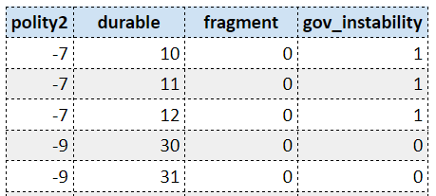
Political data
Dataset: Polity5
Polity2
Durable
Fragment
Government instability
Where m is the amount of lookback years. m = 60

Slide 5
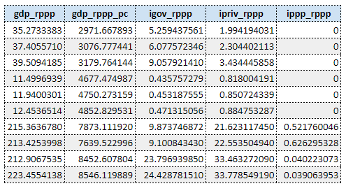
Economic data
Datasets: International Monetary Fund (IMF) & World Bank
Gross domestic product (GDP)
General government investment
Private investment
Public-private partnership
GDP per capita
gdp_per_capita_{country, year} = gdp_{country, year} / population_{country. year}

Slide 6
Data transformations
Resolve mismatching country names during merge of datasets
Selecting data from year 1960 to 2018
Polity 2 score categorized into: democratic, autocratic and anocratic
To certain columns log₁₀ and normalisation has been applied
A risk score has been calculated
After the data transformations; 7475 datapoints
Notes:
Resolve mismatching country names during merge of datasets: Caused datapoints to get lost

Slide 7

Risk score
Normalised
Score from 0 to 1

Slide 8
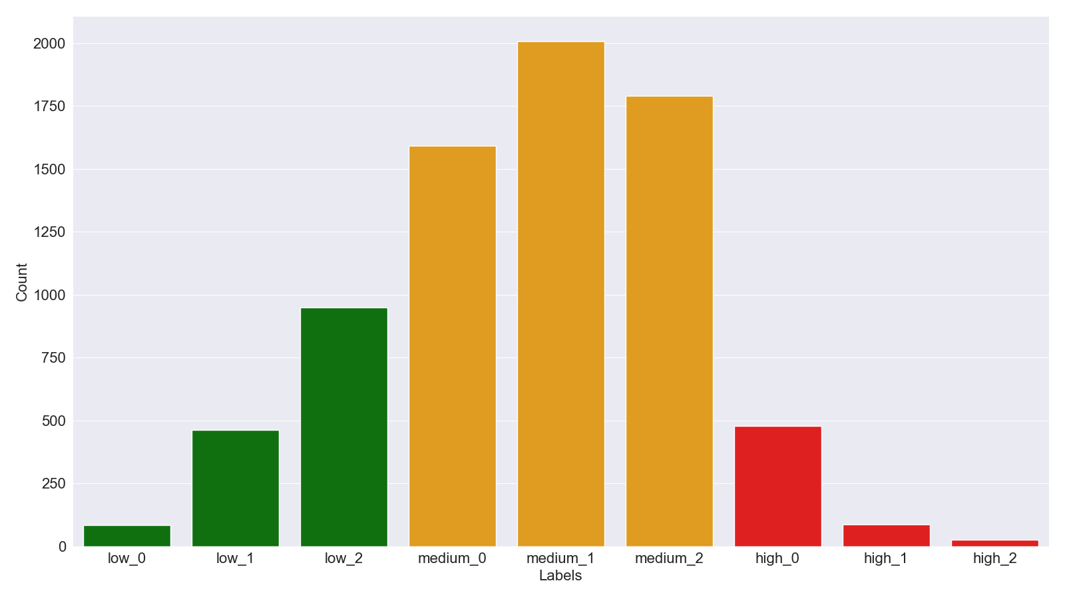

Labels
Three categories; Low, medium and high
Three sublabels 0 to 2
Resulting in 9 labels
Equal partition of the risk score (0 to 1)
Figure 3.5) A bar graph depicting the amount of rows per label.

Slide 9
Model
Key takeaways based on literature research:
SVM
Limited to two-class problems
Performs well in high-dimensional spaces
KNN
Suitable for multi-class problems
Doesn’t perform well when class distribution is uneven
FNN
Does well in handling non-linear relationships
Prone to overfitting
Bluwstein et al. (2020), Xu et al. (2022)
Notes:
De bullets hebben betrekking op ons probleem, niet algemeen Literatuuronderzoek gedaan

Slide 10
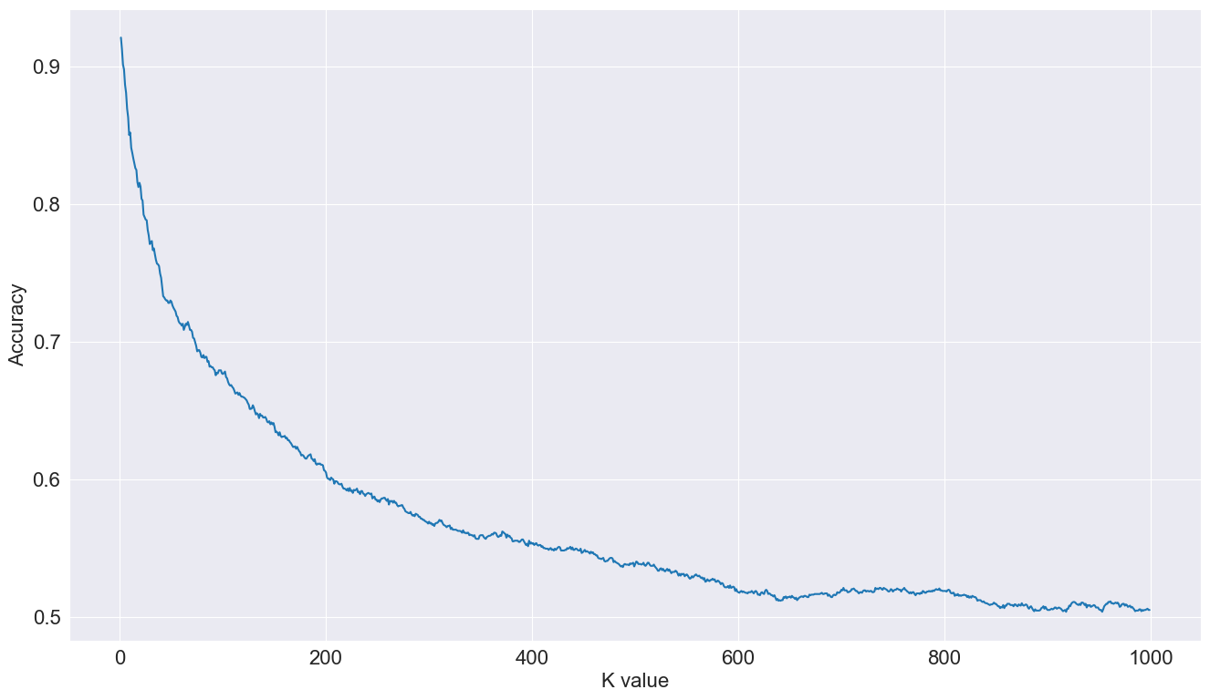
KNN
Figure 3.3) Graph depicting the accuracy per K-value from 1 to 1000.

Slide 11
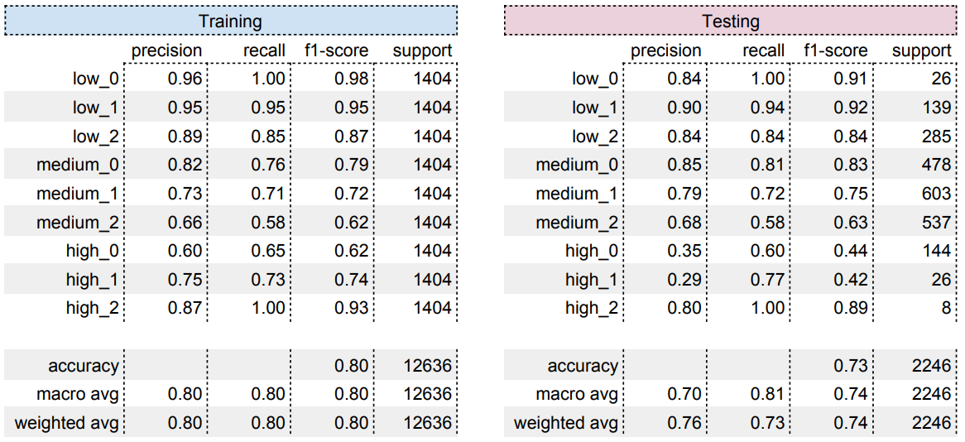
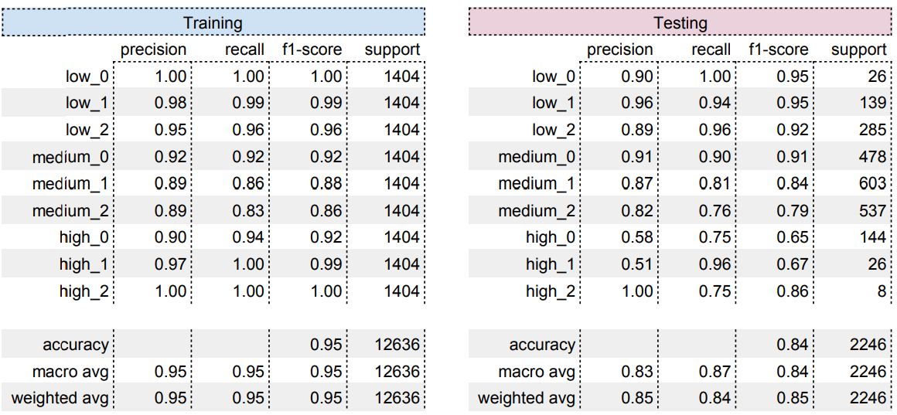
SVM
KNN
Slightly overfits
Difficulty distinguishing between medium and high-risk labels
K = 10
Overfitting
Difficulty distinguishing between high-risk labels

Slide 12
SVM
KNN
Slightly overfits
Difficulty distinguishing between medium and high-risk labels
K = 10
Overfitting
Difficulty distinguishing between high-risk labels

Slide 13
SVM
KNN
Slightly overfits
Difficulty distinguishing between medium and high-risk labels
K = 10
Overfitting
Difficulty distinguishing between high-risk labels
Notes:
Aanduiden waarom SVM en KNN overfitten

Slide 14
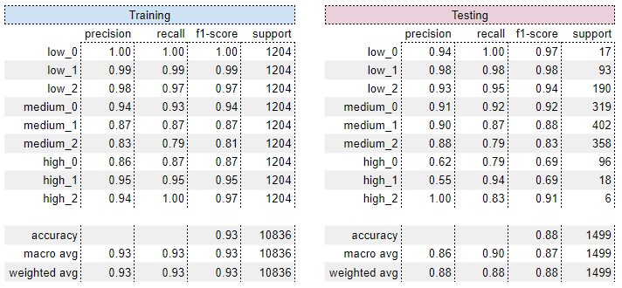
Feedforward Neural Network
High accuracy
Minimal overfitting
A lot of hyperparameters
Optimizer = Adam
hidden_layers = 1 (ReLU)
units = 256
dropout_rate = 0.2
patience = 10
learning_rate = 0.00015
Notes:
Hyperparameters can be optimized, Conclusion FNN

Slide 15
Feedforward Neural Network
High accuracy
Minimal overfitting
A lot of hyperparameters
Optimizer = Adam
hidden_layers = 1 (ReLU)
units = 256
dropout_rate = 0.2
patience = 10
learning_rate = 0.00015
Notes:
Hyperparameters can be optimized (room for improvement), Conclusion FNN

Slide 16
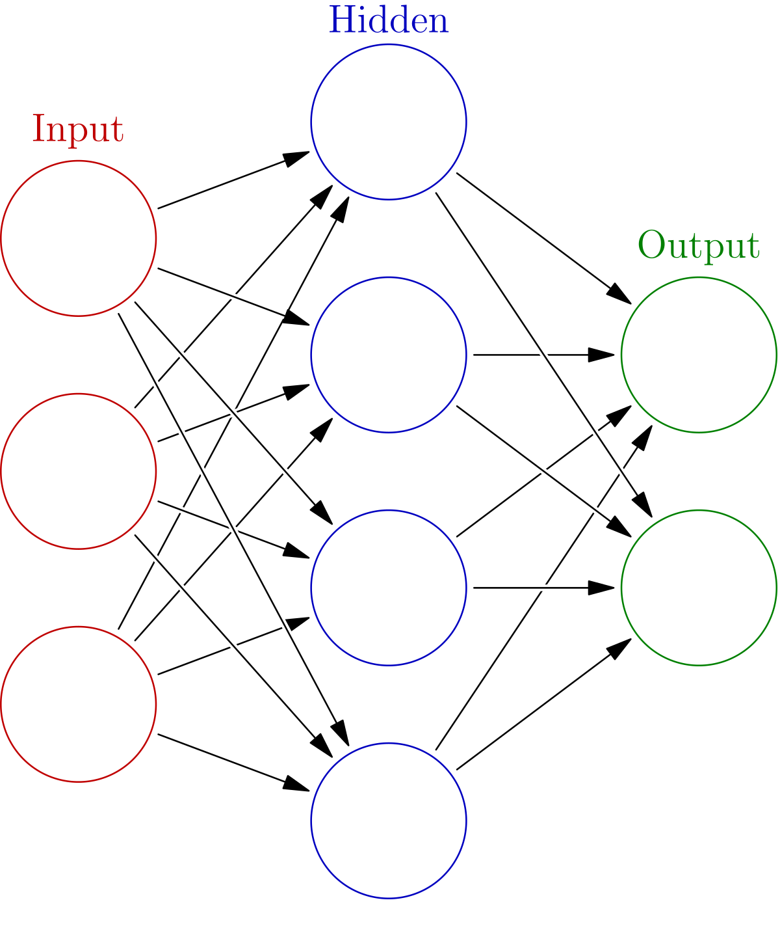
The model
Changed:
hidden_layers = 1 (ReLU) units = 1024
patience = 25 epochs = 2000
learning_rate = FactorScheduler(factor=0.995, stop_factor=0.00075, base_lr=0.002)
Did not change:
epsilon = 1e-7 beta_1 = 0.9 beta_2 = 0.999
clipnorm = None clipvalue = None global_clipnorm = None
jit_compile = True use_ema = False weight_decay = 0
dropout_rate = 0

Slide 17
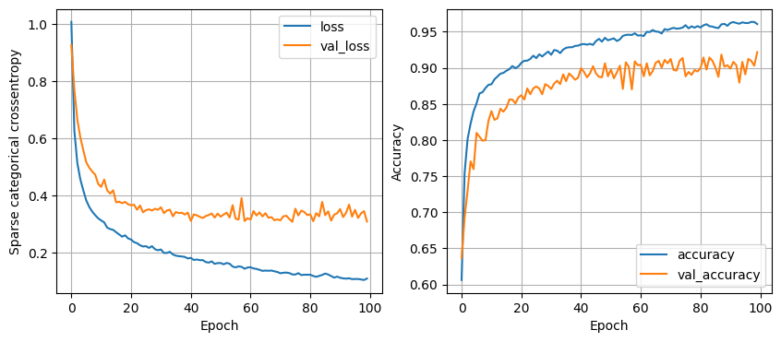
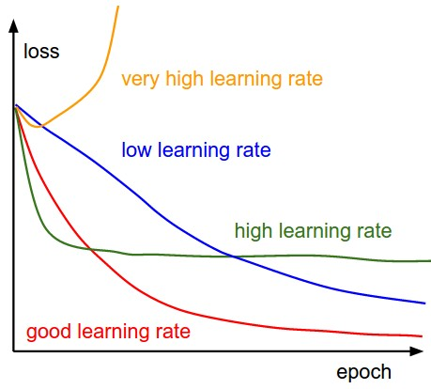
Training
Left: Training results of the loss of the model.
Right: ‘ A cartoon depicting the effects of different learning rates’. (Stanford University, z.d.).

Slide 18
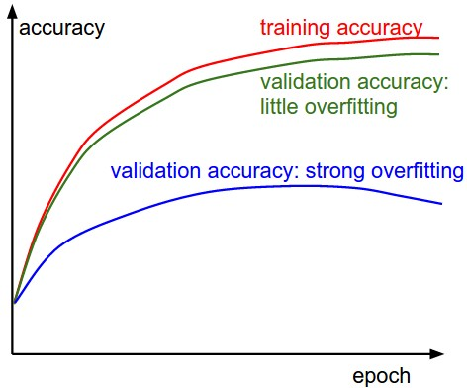
Training
Left: Training results of the accuracy of the model.
Right: ‘The gap between the training and validation accuracy indicates the amount of overfitting.’ (Stanford University, z.d.).

Slide 19
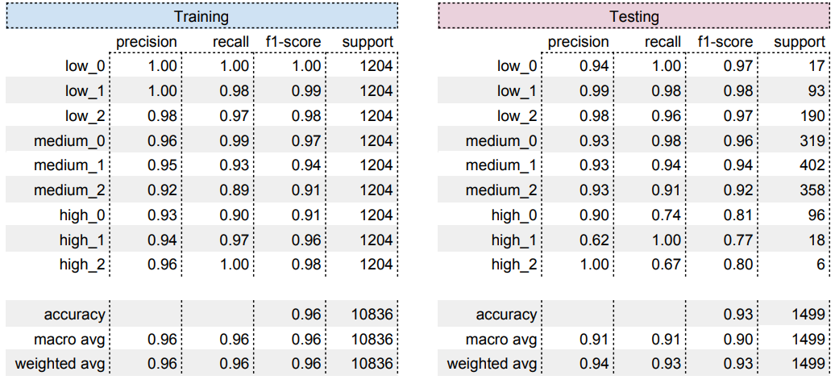
Predicting
≈0.2158 S.C.C. Loss*
≈93% Accuracy
Minimal overfitting
Minor issues predicting high risk datapoints
Table 4.1) The confusion matrices of the final model.
*S.C.C. = Sparse Categorical Cross-entropy

Slide 20
Predicting
≈0.2158 S.C.C. Loss*
≈93% Accuracy
Minimal overfitting
Minor issues predicting high risk datapoints
Table 4.1) The confusion matrices of the final model.
*S.C.C. = Sparse Categorical Cross-entropy

Slide 21
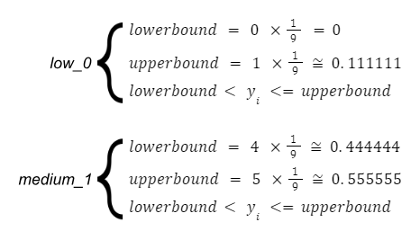
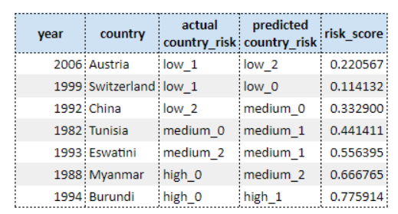
Edge cases
Table 4.2) A sample of the set of the incorrectly predicted rows,
predicted by the final model.

Slide 22
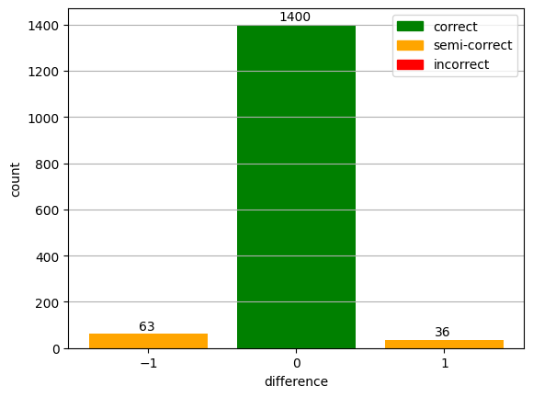
Margin of error
Difference is never more than one label
Very impactful on 3-label classification
A difference of one is classified as semi-correct
100% accuracy
Figure 4.3) The distribution depicting the difference between predicted
and observed labels, where the predictions were done by the final model.

Slide 23
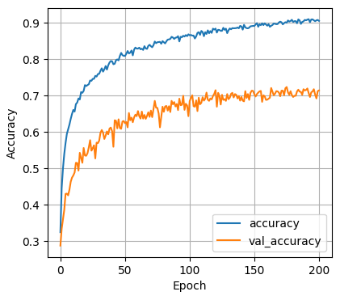
Accuracy vs Precision
Left: Training results of the accuracy of the 27-label model.
Right: ‘The gap between the training and validation accuracy indicates the amount of overfitting.’ (Stanford University, z.d.).

Slide 24
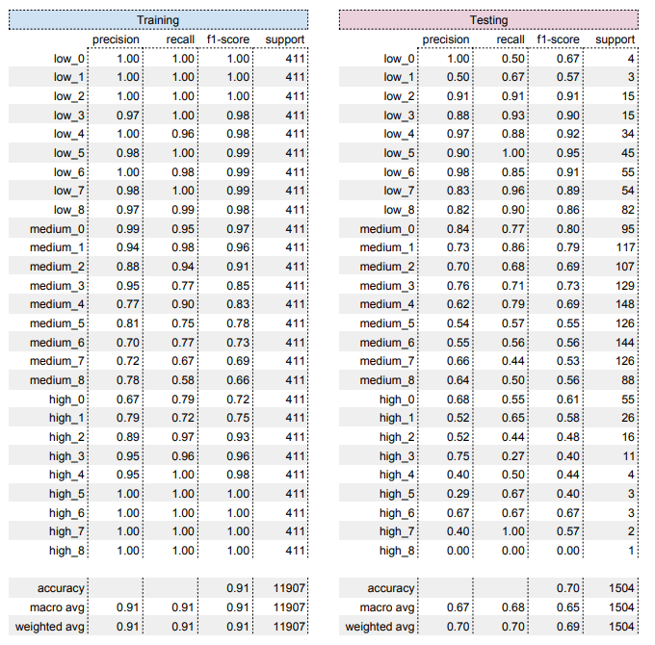
27-label predicting
9-label accuracy; 93%
Fairly precise
True precision
Notes:
True precision

Slide 25
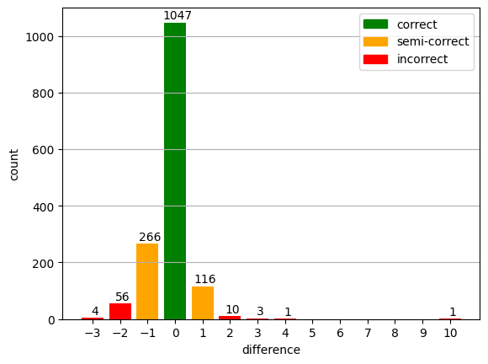
Margin of error
95% of the rows fall within the margin of error
≈71% tends to be classified as a lower-risk label
Taking the margin of error into account;
Very precise
Figure 4.6) The distribution depicting the difference between predicted and observed label (27-label model)
Notes:
Precision taking margin of error into account.
year country polity2 durable fragment gov_instability
2016 Colombia 7 59 3 0
gdp_rppp gdp_rppp_pc igov_rppp ipriv_rppp ippp_rppp
683,8214722 14358,16819 23,69633865 124,1269913 8,602406502
country_risk predicted_country_risk norm_risk
medium_4 high_5 0,48998817

Slide 26
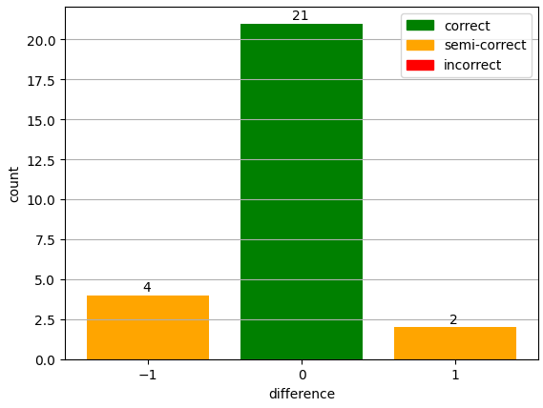
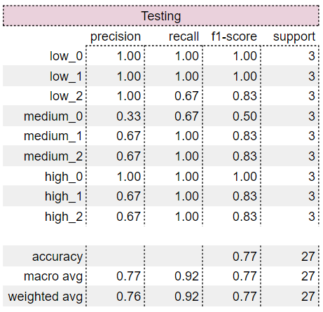
Custom validation
Table 4.4) Confusion matrix depicting the accuracy of the predictions of the model on the custom validation dataset.
Table 4.5) The distribution depicting the difference between predicted and
observed labels, where the predictions were done by the model.

Slide 27
Limitations
Risk score formula creates an enormous bias
More features is preferred, since the world is complex
More data points
Standardised country names or codes

Slide 28
Questions?

